Slide 1
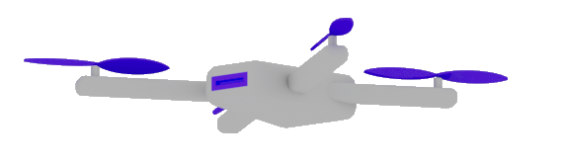
Microsoft Build

Slide 2
Semantic Kernel
Dr. Damir Dobric

Slide 3
GENERATIVE AI

Slide 4
What is a Model?
A model refers to a specific instance or version of an LLM AI

Slide 5
Available GPT Models
Ada
basic natural language understanding
classification, sentiment analysis, summarization, and simple conversation.
Babbage
more complex natural language tasks, such as reasoning, logic, arithmetic, and word analogy.
Curie
advanced natural language tasks, such as text-to-speech, speech-to-text, translation, paraphrasing, and question answering.
Davinci
Handles almost any natural language task,
as well as some multimodal tasks, such as image captioning, style transfer, and visual reasoning.
It can also generate coherent and creative texts on any topic, with a high level of fluency, consistency, and diversity.

Slide 6
AI Services
Open AI
https://platform.openai.com/docs/models
Azure Open AI https://oai.azure.com/portal/****/models

Slide 7
Generative Model Types
Embeddings Models
Completion Models
Chat Models
Semantic Search Applications
The application is based on Completion (prompts)
Chat-GPT Application

Slide 8
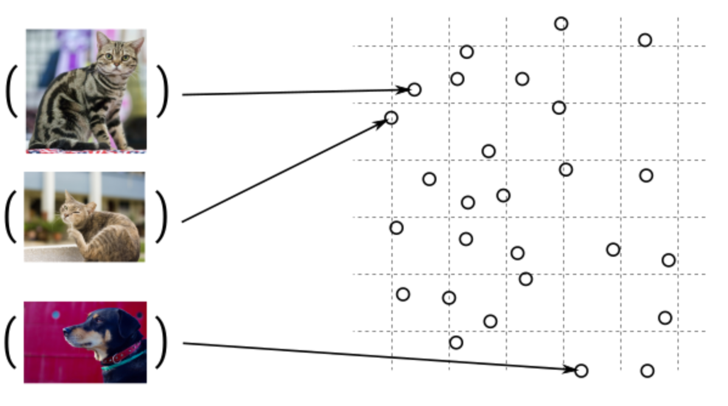
Guess, today is a nice day in Palma
Embedding Models
Today is a typical German rainy day
Two things are infinite: the universe and human stupidity; and I'm not sure about the universe.

Slide 9
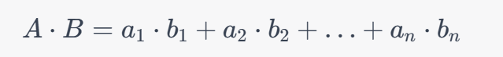
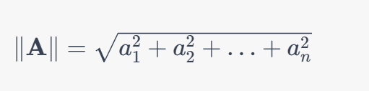
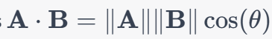
Similarity Between Multidimensional Vectors
Dot Product
The Norm
Cosine Similarity

Slide 10
DEMO
Generating Embeddings with Postman

Slide 11
When to use Embeddings?
Semantic Search
Classification
Grounding

Slide 12
Completion Models

Slide 13
What is a token?
1 token ~= 4 chars in English
1 token ~= ¾ words
100 tokens ~= 75 words
Byte Pare Encoding (Gage,1994): Wikipedia
Tokenizer: https://platform.openai.com/tokenizer
What are tokens and how to count them?
Token Pricing: Pricing (openai.com)

Slide 14
Chat Models

Slide 15
SEMANTIC KERNEL

Slide 16

Software V2
Eine neue Generation von Software
“After tomorrow”
“Tomorrow”
Quantum Computing
Software
Today
AI & Large Language Model Integration
Syntax Driven Languages

Slide 17
Semantic Kernel is an open-source SDK that lets you easily combine Generative AI Models syntactic programming languages like C# and Python.
Currently supported languages: C#, Python
Currently supported AI Services: OpenAI, Azure OpenAI, and Hugging Face
Introduction | 🦜️🔗 Langchain

Slide 18
Deep Dive into Semantic Kernel
Overview of the kernel
Creating native functions
Creating semantic functions
Understanding AI plugins
Chaining functions together
Planer
Create and run a ChatGPT plugin

Slide 19
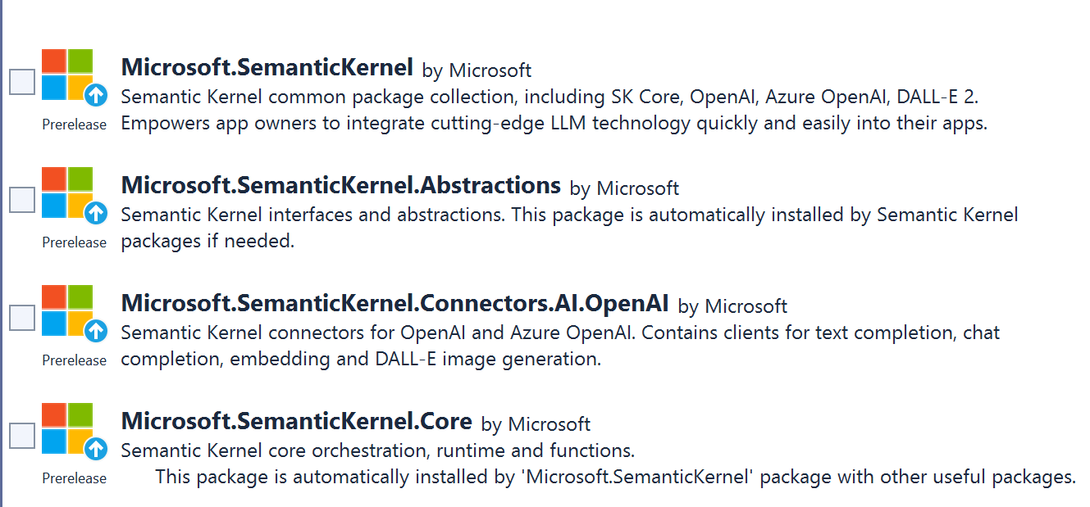
SEMANTIC KERNEL OVERVIEW

Slide 20
Semantic Kernel Initialization with Azure OpenAI
private static IKernel GetAzureKernel()
{
var kernel = new KernelBuilder()
.WithAzureAzureChatCompletionService(„chat-gpt4“,
.WithAzureTextCompletionService(„your deployed model name“,
„The endpoint of your Azure OpenAI service“,
„The API key of your Azure OpenAI service“
)
.Build();
return kernel;
}

Slide 21
Semantic Kernel Initialization with OpenAI
private static IKernel GetAzureKernel()
{
var kernel = new KernelBuilder() .WithOpenAIChatCompletionService(„chat-gpt4-turbo“,
.WithOpenAITextCompletionService("text-davinci-003“,
„Your Organization ID“,
„The API key of your OpenAI service“,
)
.Build();
return kernel;
}

Slide 22
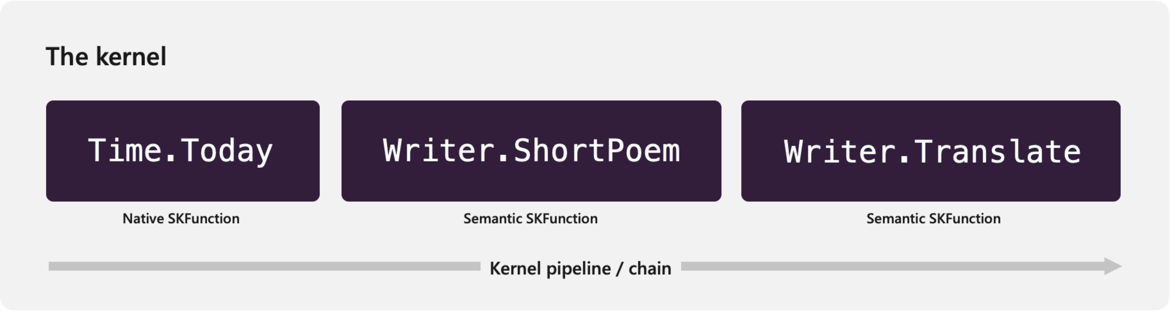
The chain of functions
Get the current time.
Generate a poem about the time, before finally.
Translate it.

Slide 23
NATIVE FUNCTIONS
[SKFunction, Description("Gets the UTC current time.")]
public string UtcNow()
{
return DateTime.UtcNow.ToString();
}
A native function is a function
defined by the code

Slide 24
SEMANTIC FUNCTIONS
Inline Functions
string prompt = @"Bot: How can I help you?
User: {{$input}}
---------------------------------------------
The intent of the user in 5 words or less: ";
A semantic function is a function
defined by the LLM prompt
Plugins
│
│─── Plugin1
│
│─── Function11
│─── Function12
└─── Plugin2
│
│─── Function21
│─── Function22
Add Ins
In-file Functions

Slide 25
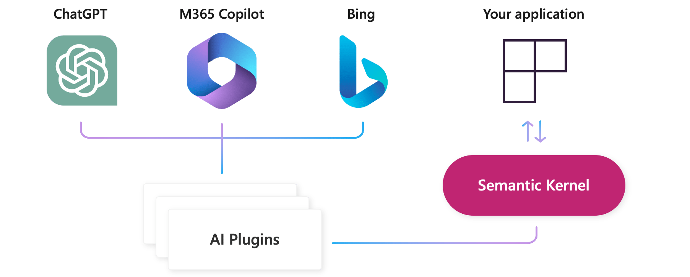
AI Plugins
Your SK application
a plugin is a group of functions
that can be exposed to AI applications
OpenAI plugin specification

Slide 26
Using variables (Templatizing)
Get the current time.
Generate a poem about the time, before finally.
Translate it.

Slide 27
Nested Functions
Get the current time.
Generate a poem about the time, before finally.
Translate it.

Slide 28
Skill

Slide 29
AutoGen Agents Meet Semantic Kernel | Semantic Kernel (microsoft.com)

Slide 30
Microsoft confidential

